Slide 1
Detecting Communities from Heterogeneous Graphs:
A context Path-based Graph Neural Network Model
Linhao Luo
Harbin Institute of Technology
Shenzhen
China
luolinhao@stu.hit .edu.cn
Yixiang Fang*
The Chinese University of Hong Kong,Shenzhen
China
fangyixiang@cukk.edu.cn
Xin Cao
The University of New South Wales
Australia
Xin.cao@unsw.edu.cn
Xiaofeng Zhang*
Harbin Institute of Technology
Shenzhen
China
zhangxiaofeng@hit .edu.cn
Wenjie Zhang
The University of New South Wales
Australia
Wenjie.zhang@unsw.edu.cn

Slide 2
Background
Context Path for Community Detection
CONTENTS
Context Path-based GNN
Experiment Results

Slide 3
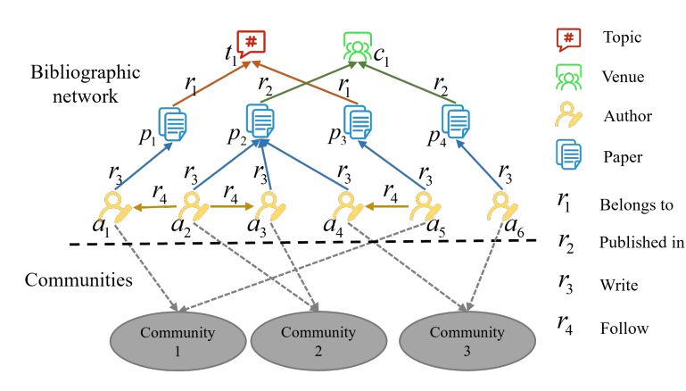
Background
Community Detection: It aims to group the graph nodes into clusters with dense inner-connection
Heterogeneous Graph: Graph with multiple types of nodes and edges
Detecting communities from a heterogeneous bibliograogic graph

Slide 4
background
Context Path for Community Detection
CONTENTS
Context Path-based GNN
Experiment Results

Slide 5
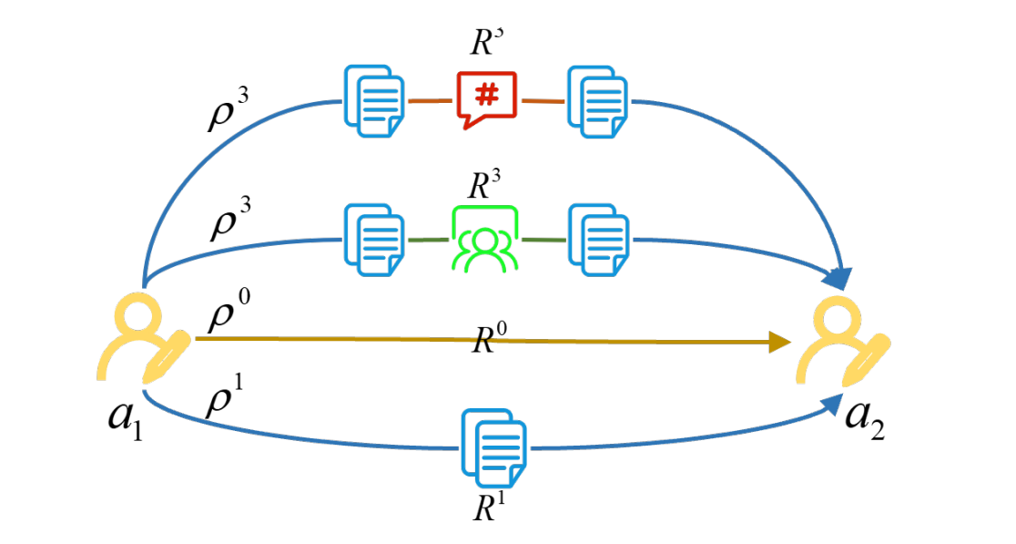
Context Path for Community Detection
Context Path
A context path is a path connecting two nodes in the primary type
denotes a sequence of nodes in the auxiliary type, when
Context paths between and

Slide 6
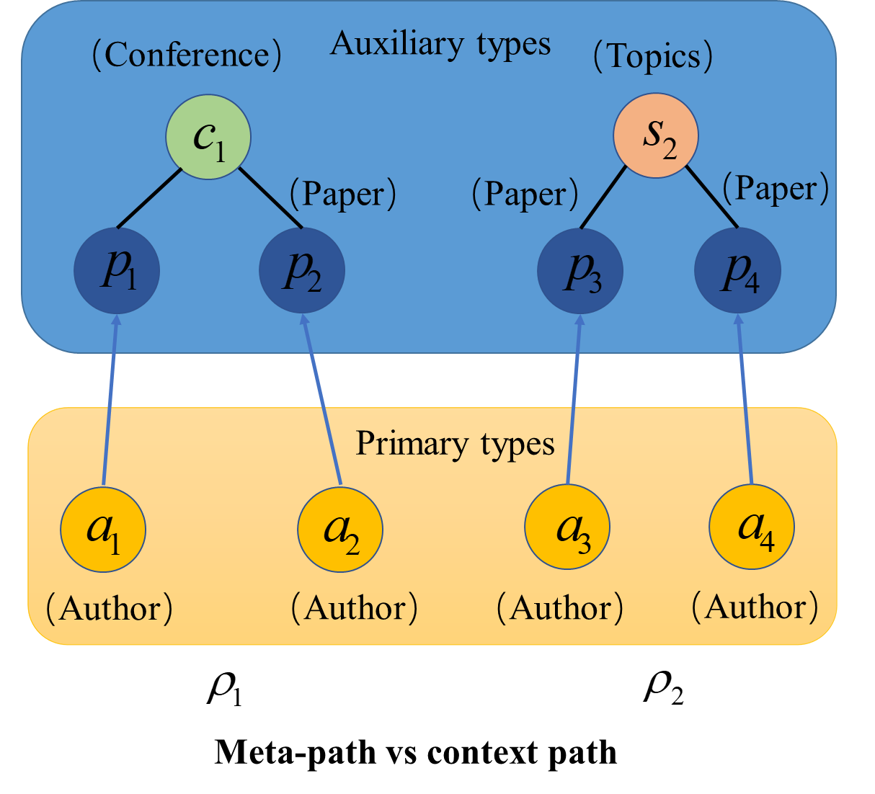
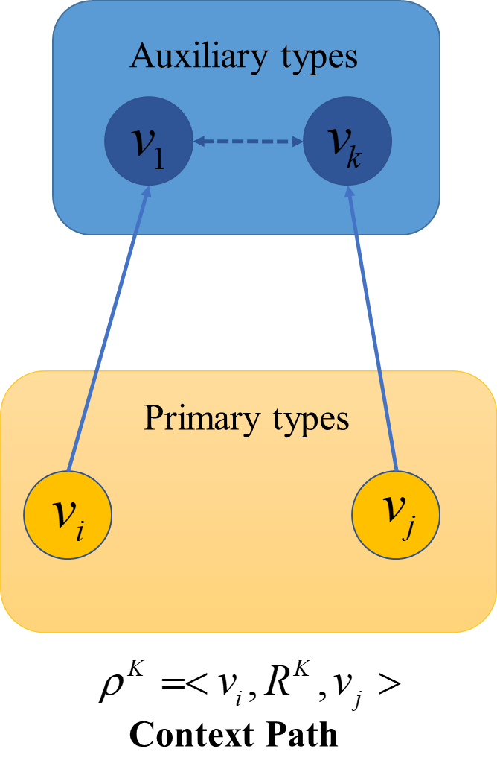
Context Path for community Detection
Difference between context path and meta-path
Semantic relationships of context path come from the different auxiliary nodes
Meta-path is to manually define the combination of the auxiliary nodes in the context path
Context path relaxes the restriction of the auxiliary nodes, which is only required to define the maximum length K
Meta-path

Slide 7
background
Context Path for Community Detection
CONTENTS
Context Path-based GNN
Experiment Results

Slide 8
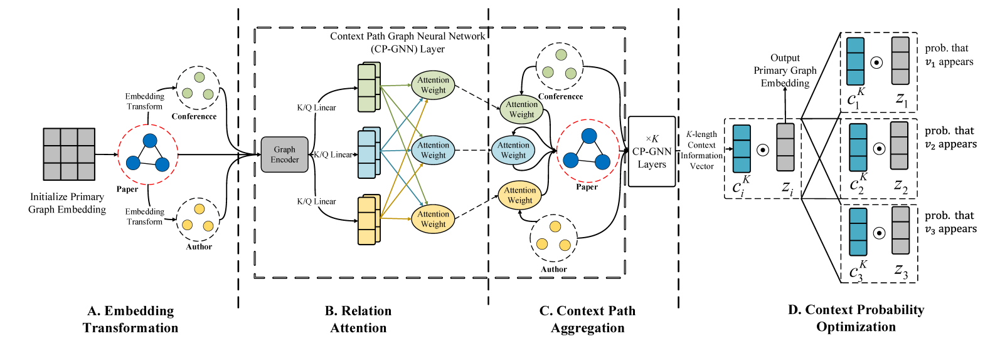
Context Path-based Graph Neural Network
The overall framework of Context Path-based Graph Neural Network(CP-GNN)

Slide 9
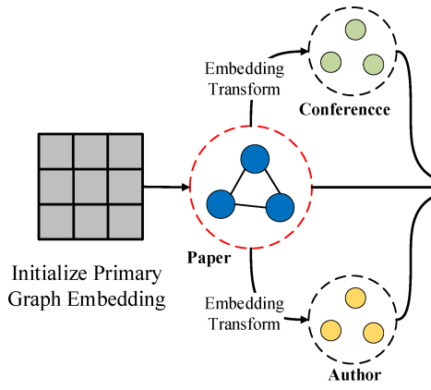
Context Path-based Graph Neural Network
Embedding Transformation Component
This component is used to transform the node embedding from the primary type to the auxiliary type along the edges
Embedding transformation from type S to type T
(6)
In this way, we only learn the embedding of nodes in the primary type thus reducing the parameters to be learned

Slide 10
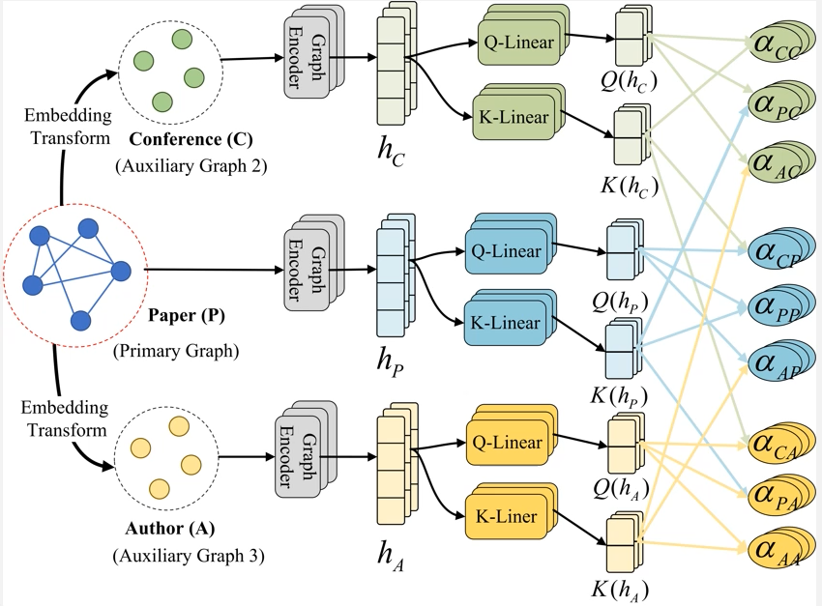
Context Path-based Graph Neural Network
Graph Encoder:
(7)
Relation Attention Score:
(8)

Slide 11
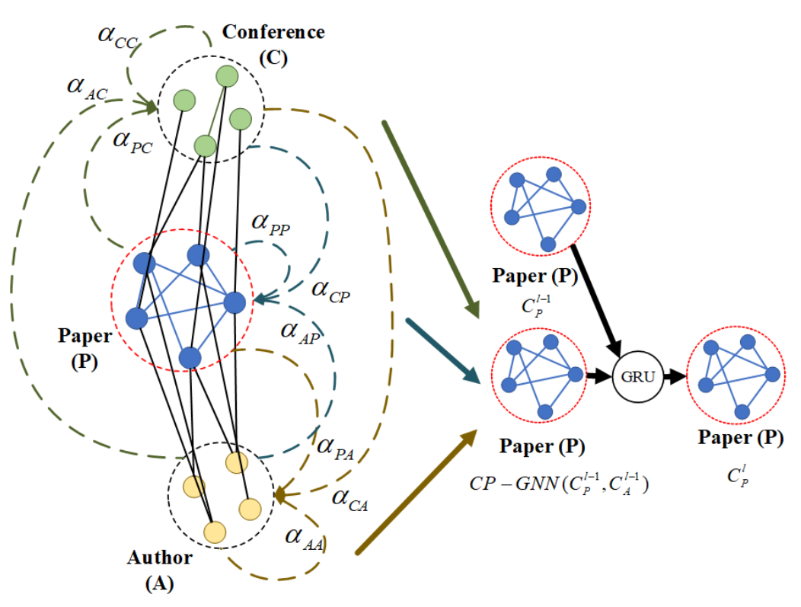
Context Path-based Graph Neural Network
Context Path Aggregation
Aims to aggregate the information along relations to generate the context information vectors
(9)
After k times message passing, CP-GNN can embed all the k-length context paths into the context vector
(10)

Slide 12
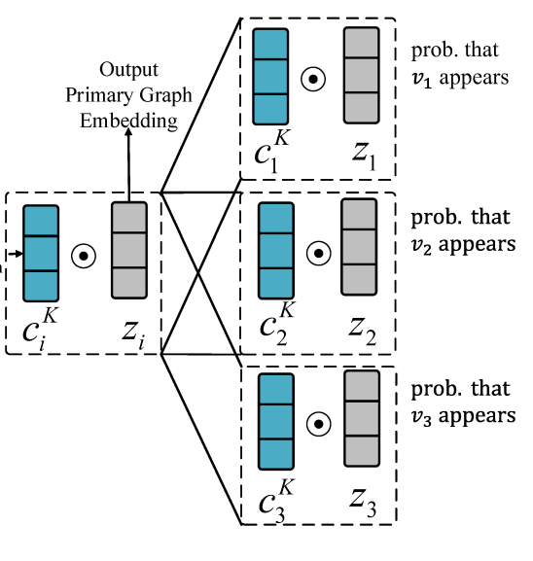
Context Path-based Graph Neural Network
Context path probability：
(3)
Object function
Context Path Length Attention
(4)
Loss function
(5)

Slide 13
background
Context Path for Community Detection
CONTENTS
Context Path-based GNN
Experiment Results

Slide 14
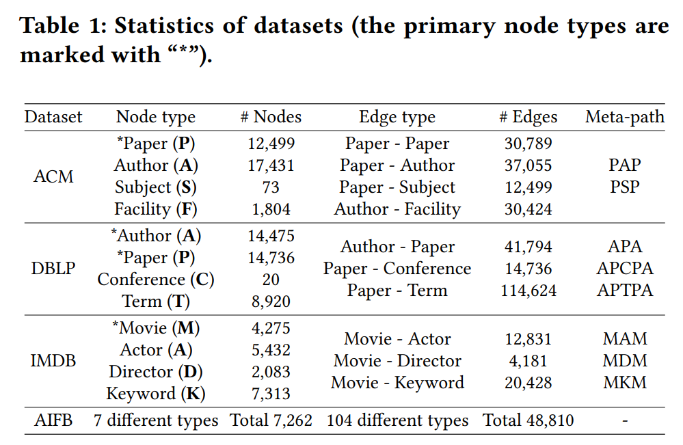
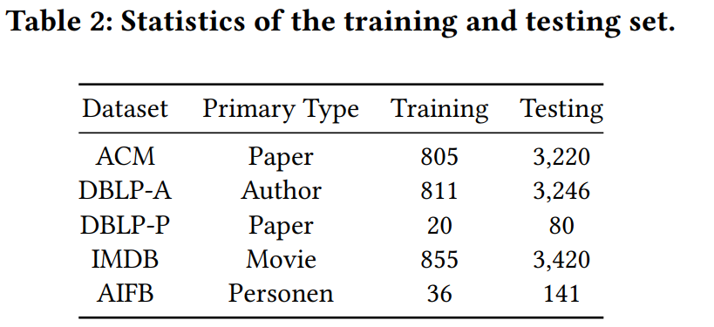
Experiment Results
Dataset:
ACM, DBLP,IMDB,AIFB
Metrics:
F1,NMI,ARI,Purity
Baselines:
Unsupervised: InfoMap, Node2vec, Metapath2vec, HIN2vec
Supervised: Label Propagation(LP),GCN,
GAT,LGNN,HAN,HGT

Slide 15
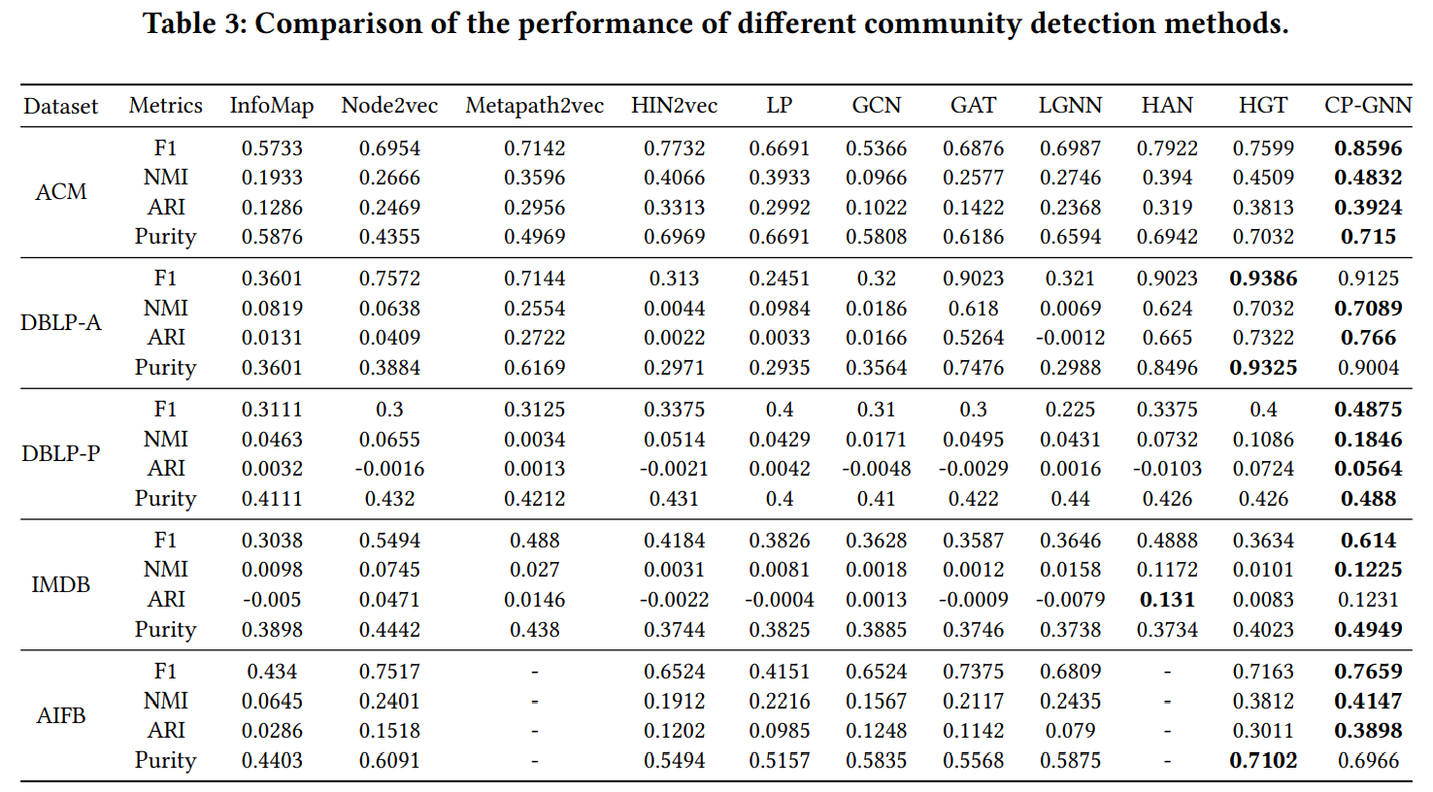
Experiment Results

Slide 16
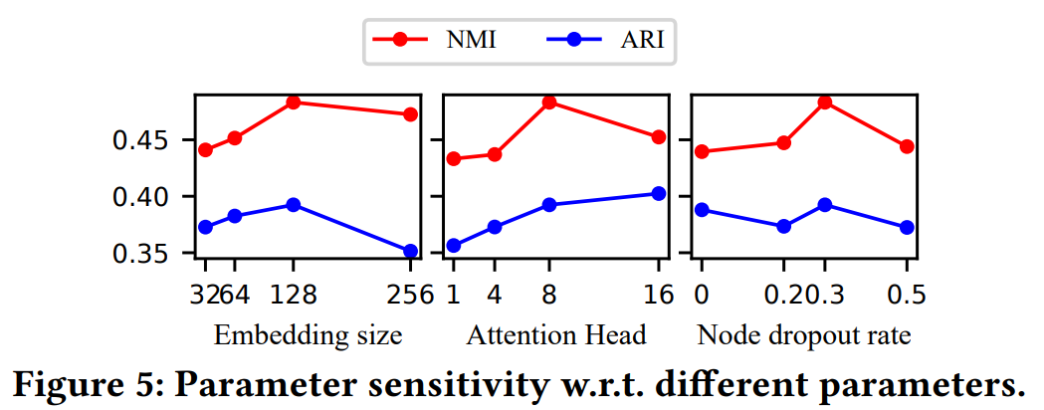
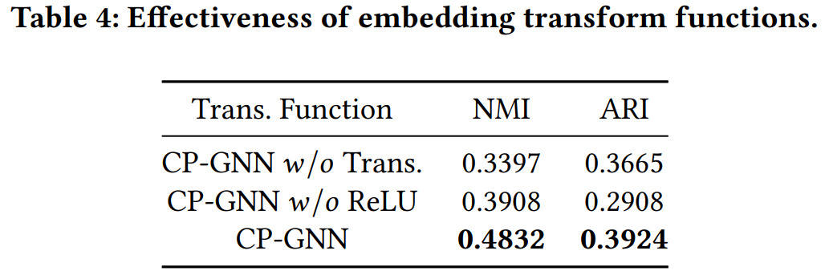
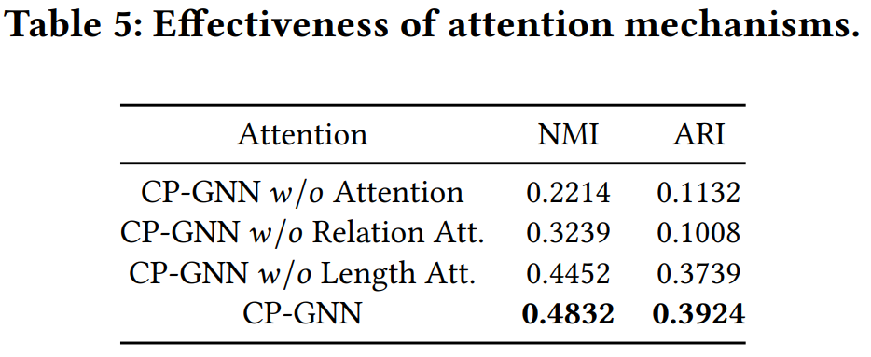
Experiment Results

Slide 17
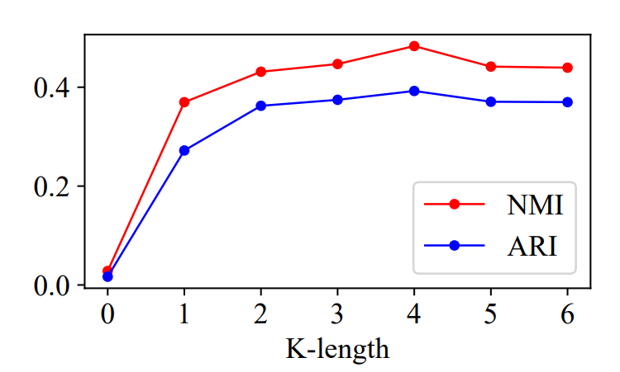
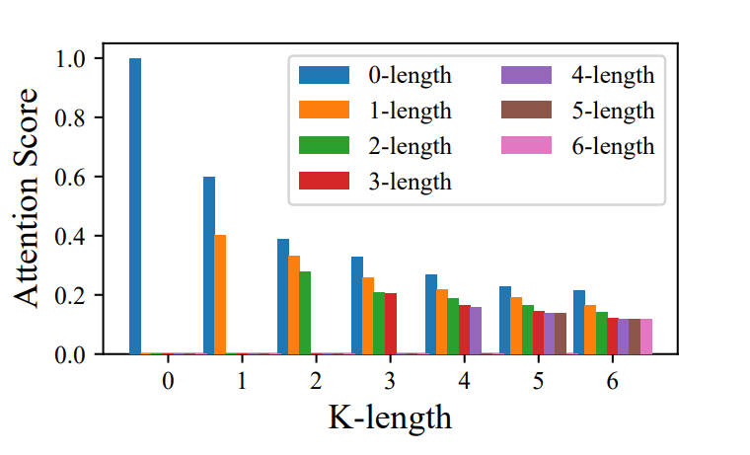
Experiment Results
Performance under different K
Attention weight of each context path length

Slide 18
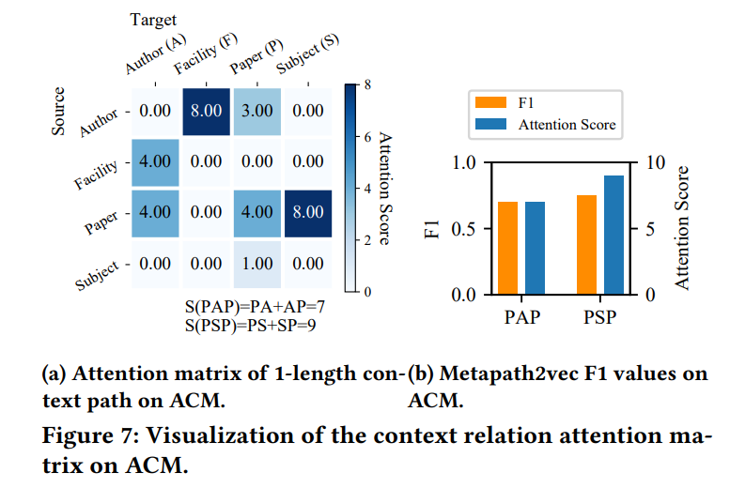
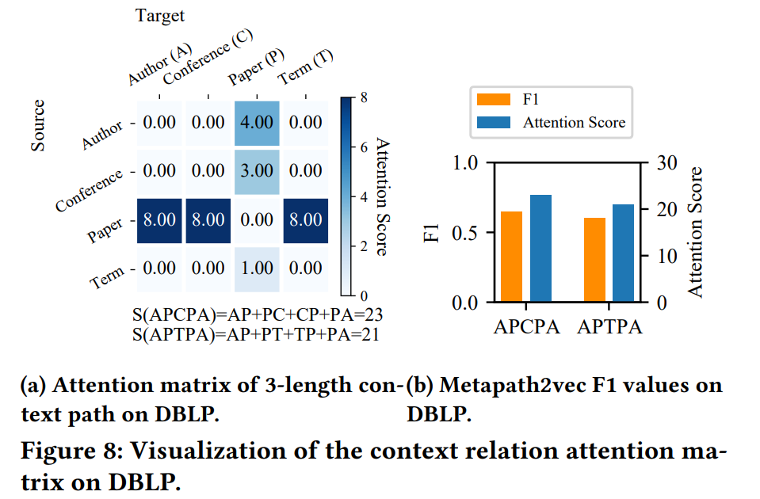
Experiment Results

Slide 19
TAHNKS FOR WATCHING

